Slide 1

Optimisation of Multi Cell FGM Tubes Under Crushing Load
Capstone Project-(Fall 2024-25)
Second Review
Project Member(s) Name
Kevin GD (21BMV1120)
Hrishkesh Kothapalli (21BMV1112)
Adema Sai Vedavyas Reddy (21BMV1022)
Guided by
(Dr. Elango M)
School of Mechanical Engineering

Slide 2
Agenda
Introduction
Literature survey
Problem Definition
CAD Model Design
Objective of the project
Concept and Objective
Target Audience
Methodology
Work done
Work to be done
References

Slide 3
Introduction
Multi-cell structures have been extensively studied for their outstanding performance as potential energy absorbers. Unlike existing multi-cell tubes with a uniform thickness (UT), this paper introduces a functionally graded thickness (FGT) to multi-cell tubes under dynamic impact, which can be fabricated by an extrusion process. A numerical model is first established using the nonlinear finite element analysis code LS-DYNA and validated with experimental data. Based on a numerical study, the thickness gradient parameters in different regions have considerable effects on the crashworthiness of the FGT multi-cell tubes. Moreover, the FGT multi-cell tubes are able to absorb more energy while yielding a similar level of peak impact force to the UT multi-cell tubes.

Slide 4
Introduction
Finally, multi objective optimizations of the UT and FGT multi-cell tubes are then performed to determine the optimal gradient parameters that simultaneously improve the specific energy absorption (SEA) and reduce the maximum impact force. In these optimizations, the multi objective particle optimization (MOPSO) algorithm and response surface (RS) surrogate modeling technique are adopted. The optimization results demonstrate that the FGT multi-cell tubes produce more competent Pareto solutions than the conventional UT counterparts; similar gradients in the outer walls and stronger internal ribs are recommended for the FGT multi-cell tubes because of their improved interactions

Slide 5
Literature Survey
Sl. No. | Paper Title and Year of Publication | Important findings
1 | Crashworthiness design for functionally graded foam-filled bumper beam | Investigate crashworthiness of functionally graded foam (FGF)-filled bumper beams for enhanced energy absorption and lightweight automotive design. Conventional hollow bumper beams made of steel or aluminum experience localized bending collapse during impact, leading to low energy absorption. FGF-filled beams use foam with variable density controlled by a gradient exponential parameter mm, enhancing structural rigidity and crash performance compared to uniform foam (UF) fillings. Can be used here to understand FGFF and proceed with our project.
2 | Crashworthiness design for functionally graded foam-filled thin-walled structures | Foam-filled thin-walled structures enhance energy absorption and weight reduction, with applications in automotive, aerospace, defense, and transportation industries. FGF fillers, introduced in this study, vary in density across the depth with a gradient function controlled by the gradient exponential parameter mmm, offering improved crashworthiness over uniform foam (UF) fillers. FGF-filled columns outperform uniform foam in crashworthiness metrics such as SEA and peak force. The optimization results yield superior designs, showing the potential of FGF materials for lightweight energy-absorbing applications.

Slide 6
Literature Survey
Sl. No. | Paper Title and Year of Publication | Important findings
1 | Dynamic crashing behavior of new extrudable multi-cell tubes with a functionally graded thickness | A novel multi-cell tube with functionally graded thickness (FGT) is proposed, replacing conventional uniform thickness (UT) multi-cell tubes for dynamic impact scenarios. A numerical model based on the nonlinear finite element analysis (LS-DYNA) was developed and validated against experimental data, ensuring accuracy in deformation patterns, impact forces, and energy absorption behavior. (Incorporated into the Project) The optimal FGT structure reduced peak forces while maintaining higher post-deformation impact forces, resulting in a 19.51% increase in specific energy absorption (SEA) compared to UT tubes.
2 | Dynamical bending analysis and optimization design for functionally graded thickness (FGT) tube | The force plate is a rubber plate with a single sensor at the bottom, measuring 250 mm x 150 mm x 10 mm, and capable of handling a maximum load of 60 kg. It uses a flexy-force pressure sensor from TEKSCAN connected to an ATmega 328 microcontroller. The prototype was tested on students for standing and walking biomechanics analysis. The force plate recorded vertical ground reaction forces, providing data similar in quality to commercial versions.

Slide 7
Literature Survey
Sl. No. | Paper Title and Year of Publication | Important findings
1 | Effect of Trigger Mechanism on the Load – Displacement Response and Folding Pattern of Aluminum Tubes | Investigating the effect of different triggering mechanisms on the load-displacement response and folding patterns of square aluminum tubes under quasi-static axial compressive load using LS-DYNA simulations. Triggering mechanisms influence both the load-displacement response and folding pattern. Even without a physical trigger, numerical precision can initiate folding. Hole patterns provided the lowest folding initiation force. Chamfered and geometrically imperfect tubes showed asymmetric or mixed folding modes. Rounded corners reduced folding initiation forces and induced mixed folding behavior. Very much required for Belytschko-Tsay (BT) shell elements with 5 integration points through the thickness and one integration point in the plane of the shell for numerical model.
2 | Energy Absorption of a Novel Lattice Structure-Filled Multicell Thin-Walled Tubes Under Axial and Oblique Loadings | The optimization yielded Pareto fronts comparing the crashworthiness of FGT and UT tubes, demonstrating that FGT is superior in SEA but has higher Fmax. The trade-off between SEA and Fmax suggests that while FGT is better in terms of energy absorption, UT might be preferred in scenarios requiring lower peak forces. The ideal maximum SEA for FGT was 0.83 J/g, whereas UT achieved 0.68 J/g. Conversely, the ideal minimum Fmax was 1.88 kN for FGT, compared to 1.19 kN for UT. MOPSO was employed due to its fast convergence and well-distributed Pareto fronts, efficiently addressing the multiobjective problem.

Slide 8
Literature Survey
Sl. No. | Paper Title and Year of Publication | Important findings
1 | Functionally graded material via L‑PBF: characterisation of multi‑material junction between steels (AISI 316L/16MnCr5), copper (CuCrZr) and aluminium alloys (Al‑Sc/AlSi10Mg) | Joints between various metal combinations were studied : AISI 316L stainless steel & CuCrZr alloy AISI 316L stainless steel & 16MnCr5 low-alloy steel Al-Sc alloy & AlSi10Mg alloy. Further investigation into advanced laser sources and non-destructive testing techniques like Neutron Imaging (NI) is recommended. The data on this materials which is a multi metal material alloy can be used in the composite aspect of this project.
2 | Multi objective crashworthiness optimization design of functionally graded foam-filled tapered tube based on dynamic ensemble meta model | A new foam-filled thin-walled structure called Functionally Graded Foam-Filled Tapered Tube (FGFTT) is proposed for its superior energy absorption capacity and stability. The structure consists of graded density foam and a thin-walled tapered tube. The new optimization method using dynamic ensemble metamodeling and MOPSO yields a Pareto front for SEA and PCF. FGFTT-DGPs emerge as excellent energy absorbers for vehicle engineering, outperforming UFTTs in most cases. The lateral loading data on this Foam Filled FGM can be very useful.

Slide 9
Literature Survey
Sl. No. | Paper Title and Year of Publication | Important findings
1 | Multi objective crashworthiness optimization of functionally lateral graded foam-filled tubes | This paper investigates two types of Functionally Lateral Graded Foam-Filled Tubes (FLGFTs) and compares their energy absorption performance with ordinary uniform foam-filled tubes (UFTs). Both FLGFTs exhibit superior crashworthiness to UFTs of the same weight. Without bonding, Type B-FLGFT outperforms Type A-FLGFT when PCF is within the range of 140–158 kN.With bonding, Type B-FLGFT outperforms Type A-FLGFT when PCF is within the range of 180–219 kN. MOSPO Algorithm on FF-Lateral FGM data can be incorporated.
2 | Multi objective optimization of multi-cell sections for the crashworthiness design | Multi-Criteria Evaluation (COPRAS Method):7×7 tube configuration was identified as the best design, balancing axial and oblique load conditions. Kriging modeling and Multi objective Particle Swarm Optimization (MOPSO) were used to optimize tube designs. Single load case (SLC) optimizations may yield suboptimal designs under other load conditions. In multi-load case (MLC) optimizations, internal ribs shift from the center to the edges as load angle increases from axial to oblique, improving the balance of performance. These different optimization techniques are very useful.

Slide 10
Literature Survey
Sl. No. | Paper Title and Year of Publication | Important findings
1 | On design of multi-cell tubes under axial and oblique impact loads | Investigate the crashworthiness of multi-cell tubes with different cell numbers under axial and oblique loads to determine optimal configurations for energy absorption (EA) and peak force (Fmax). Increasing cell number enhances EA but introduces higher Fmax. MLC optimization ensures robust designs across various loading conditions, providing better energy absorption under combined axial and oblique impacts. Complex Proportional Assessment (COPRAS): Used for multi-criteria decision-making based on load angle variations.
2 | Parametric analysis and multi objective optimization for functionally graded foam-filled thin-wall tube under lateral impact | Objective: Investigate the bending behavior and crashworthiness of functionally graded foam (FGF)-filled thin-walled tubes under lateral impact, compared to traditional uniform foam (UF). Parametric Study Results: FGF tubes absorb more energy but generate higher peak forces than UF tubes. Key parameters influencing performance include: Grading exponent (m) for foam density. Density range (Δρ) across the foam layers. Wall thickness (t) and yield stress (σy) of the tube material. Optimization Approach: Multi-objective particle swarm optimization (MOPSO) combined with Kriging models to maximize SEA and minimize Fmax. Pareto front analysis used to identify optimal solutions balancing SEA.

Slide 11
Problem Definition
In automotive engineering, thin-walled structures have been extensively used because of their exceptional performance in energy absorption and their light weight which is responsible for absorbing approximately 50% of the kinetic energy of the vehicle during a full frontal collision.
Various Research Methodologies, Theoretical and Analytical Models, and Research gaps had been successfully studied. As suggested the LS-DYNA numerical models will be simulated to get results, which will be compared against the Source Research paper for validation.
Further our Research could be carried out, extended to -
i) Crushing Analysis with Simple walls without Lattice Structure
ii) Crushing Analysis with Walls with Lattice Structure (Hexagonal)
iii) Crushing Analysis with Walls reinforced with PU Foam
These results would then be further processed to refine and optimize the structure and increase efficiency.

Slide 12
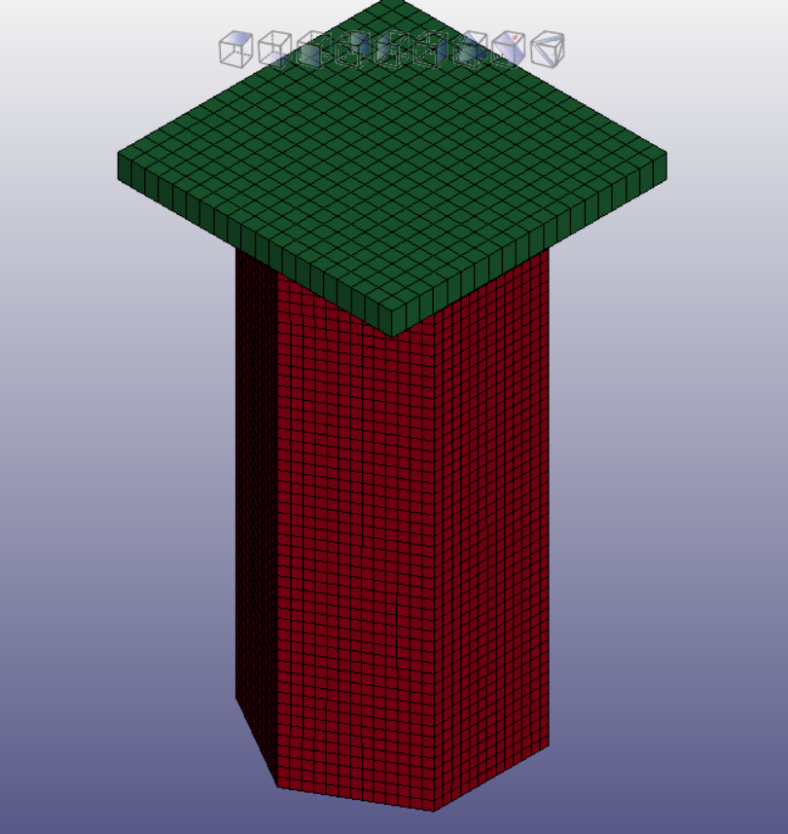
CAD MODEL DESIGN

Slide 13
CAD MODEL DESIGN
Geometric Details
Length = 200 mm
Edge Side = 75mm
No internal ribs (basic design)
No of elements along the edge = 50 elements (volumes)
Ram size (independent to analysis)
Ram weigth = 263 kg
Ram initial velocity = 10m/s
The triggers are places at a central distance from the distal end of the tube.
The triggers are approximately half the wavelength of one fold.
The depth of the triggers are set at 0.2mm.
Grid Independence Test (GIT) is successfully performed.

Slide 14
Concept and Objective
The paper titled “Dynamic Crashing Behavior of New Extrudable Multi-Cell Tubes with Functionally Graded Thickness” investigates the crashworthiness of multi-cell tubes with a functionally graded thickness (FGT), which differs from traditional uniform thickness (UT) tubes. The concept of FGT is explored to improve energy absorption during impacts by varying the thickness across different regions of the tube. This study highlights the manufacturing advantages of such tubes via extrusion processes and investigates their crash performance under dynamic impact.
The objective of the study is to:
Analyze the crashworthiness of multi-cell tubes with FGT, fabricated through extrusion.
Compare the crash performance between FGT and traditional UT multi-cell tubes in terms of specific energy absorption (SEA), maximum impact force (Fmax), and crash force efficiency (CFE).
Use finite element modeling (FE) via LS-DYNA to simulate dynamic impact loading and validate with experimental data.
Perform multio bjective optimizations using particle swarm optimization (MOPSO) to simultaneously enhance energy absorption and reduce impact forces, with an emphasis on improving both SEA and Fmax.The study concludes that FGT multi-cell tubes outperform UT tubes in terms of crashworthiness, offering better energy absorption capabilities while maintaining similar peak impact forces ￼.

Slide 15
Goals
Goal:
Creating a Geometric Model:
This is no conventional way, a model must me crated using various coordinate parameters in LS-DYNA with all the physical, variable parameters are specified including model, ram, etc.
Perform Grid Independence Test:
After carefully selecting and deciding the physical parameters, to achieve solution accuracy a grid independence test need to be performed which will make the solution independent to the number of grid elements/ cells making the solution converge.
Perform Optimisation:
Perform various numerical analysis using LS-DYNA compare and conlude the results and optimize the material composition in Functionally Graded Material (FGM).
4. Conclusion:
Results need to be compared between the different material compositions suggest the optimal choice for selected applications.

Slide 16
Target audience
Manufacturers and other CNC Machinists in resource-constrained settings.
Rapid Prototyping Companies seeking affordable technology solutions for FGM integration.
Researchers in Automobile and Aerospace who need low-cost, customizable materials.
Educational institutions looking to integrate FGM material sciences analysis into their curriculum.

Slide 17
Methodology
Solid design of Geometrical Model.
Defining the constraints and other parameters.
Initial Solution.
Performing Grid Independence Test.
Final Solution with Solution Accuracy.

Slide 18
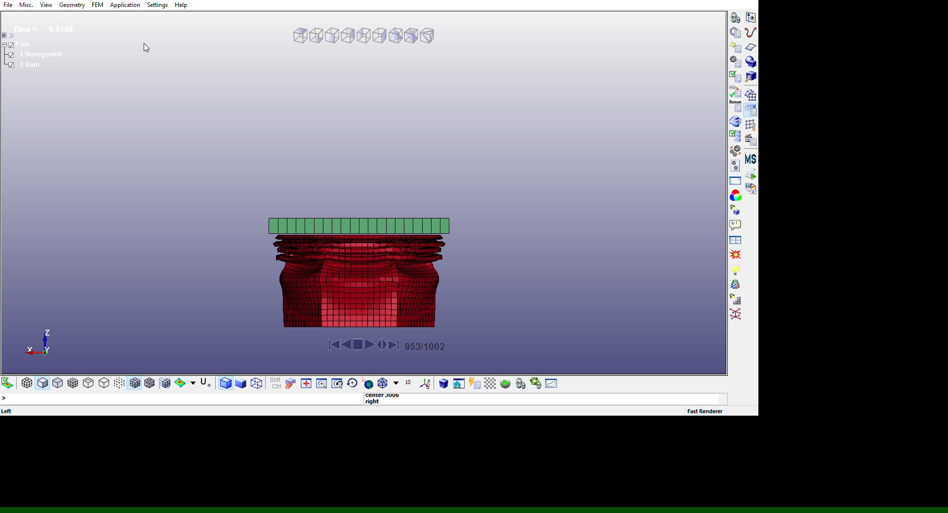
SIMULATION

Slide 19
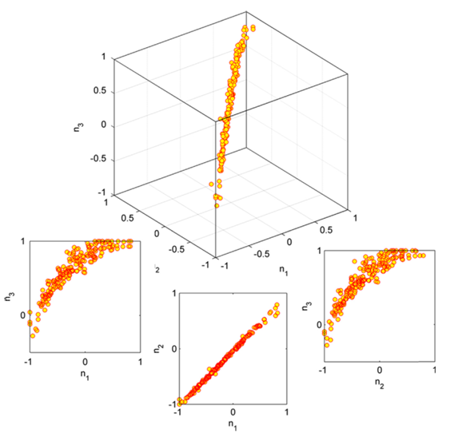
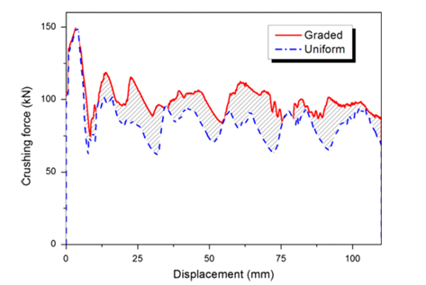
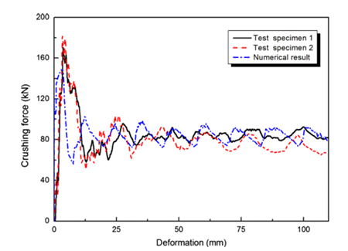
Plots
Distribution of Pareto solutions of the FGT multi-cell tubes.

Slide 20
Work Done
Research methodologies have been employed and other theoretical and analytical models have been selected:
• Parametric Study ; Thickness Gradient, Cell Number and Arrangement, Material Properties
• Comparative Analysis; Uniform Thickness Tubes, Different Geometrical Configurations
• Analytical and Empirical Validation; Energy Absorption Formula, Crushing Force Models
• Design Optimization; response surface methodology (RSM)
• Quantitative Metrics for Performance Evaluation; Specific Energy Absorption (SEA), Peak Crushing
• Sensitivity Analysis
• complex proportional assessment (COPRAS) method
• multi-criteria decision-making (MCDM) problem
• Kriging model and optimization algorithm
• separate load case (SLC)
• multiple load cases (MLC)

Slide 21
Work Done
One iteration of the Entire Analysis has been performed.
Crushing analysis with simple walls had been performed and the results are also extracted successfully.
Grid Independence Test (GIT) has been successfully performed .
In this study, if we
constrain Fmaxr150 kN for a quantitative comparison between
FGT and UT multi-cell structures, the optimal solutions can be
simply selected from the intersection between the Pareto frontiers
and the horizontal line of Fmax¼150 kN
The results were as follows, the SEA of the FGT structure increases to 58.94 kJ/kg by 19.51%.

Slide 22
Work to be done
The iterations need to be repeated for
Crushing Analysis with Walls with Lattice Structure (Hexagonal)
Crushing Analysis with Walls reinforced with PU Foam
The results need to compared to come up with an optimal combination or material composition for selective purposes.

Slide 23
References
1. Cortis, D., Orlandi, D., Pilone, D., Shinohara, T., Grazzi, F., Planell, O.S., Broggiato, G., & Campana, F. (n.d.). Functionally graded material via L‑PBF: Characterisation of multi‑material junction between steels (AISI 316L/16MnCr5), copper (CuCrZr) and aluminium alloys (Al‑Sc/AlSi10Mg).
2. Fang, J., Gao, Y., Sun, G., Zheng, G., & others. (2015). Dynamic crashing behavior of new extrudable multi-cell tubes with a functionally graded thickness. International Journal of Mechanical Sciences. DOI: 10.1016/j.ijmecsci.2015.08.029
3. Fang, J., Gao, Y., Sun, G., Qiu, N., & others. (2015). On design of multi-cell tubes under axial and oblique impact loads. Thin-Walled Structures. DOI: 10.1016/j.tws.2015.07.002
4. Kocabas, G.B., Yalcinkaya, S., Cetin, E., & Sahin, Y. (n.d.). Energy absorption of a novel lattice structure-filled multicell thin-walled tubes under axial and oblique loadings.
5. Sun, G., Li, G., Hou, S., Li, W., & others. (2010). Crashworthiness design for functionally graded foam-filled thin-walled structures. Materials Science and Engineering A. DOI: 10.1016/j.msea.2009.11.022
6. Yin, H., Wen, G., Hou, S., & others. (2013). Multiobjective crashworthiness optimization of functionally lateral graded foam-filled tubes. Materials & Design (1980-2015). DOI: 10.1016/j.matdes.2012.08.033

Slide 24
References
7. Xiao, Z., Fang, J., Sun, G., & Li, Q. (2015). Crashworthiness design for functionally graded foam-filled bumper beam. Advances in Engineering Software. DOI: 10.1016/j.advengsoft.2015.03.005
8. Fang, J., Gao, Y., Sun, G., Li, Q., & others. (2014). Parametric analysis and multiobjective optimization for functionally graded foam-filled thin-wall tube under lateral impact. Computational Materials Science. DOI: 10.1016/j.commatsci.2014.03.044
9. Hou, S., Li, Q., Yang, X., & others. (2008). Multiobjective optimization of multi-cell sections for the crashworthiness design. International Journal of Impact Engineering. DOI: 10.1016/j.ijimpeng.2007.09.003
10. Yin, H., Wen, G., & others. (2013). Multiobjective crashworthiness optimization design of functionally graded foam-filled tapered tube based on dynamic ensemble metamodel. Materials & Design (1980-2015).
11. Sun, G., Tian, X., Fang, J., Xu, F., & others. (2015). Dynamical bending analysis and optimization design for functionally graded thickness (FGT) tube. International Journal of Impact Engineering. DOI: 10.1016/j.ijimpeng.2014.12.007
12. El-Hage, H., Mallick, P. K., & Zamani, N. (n.d.). Effect of triggering mechanism on the load-displacement response and folding pattern of square aluminum tubes. University of Windsor, Windsor, Ontario, Canada; University of Michigan-Dearborn, Dearborn, MI, USA.

Slide 25
Thank you

